Slide 1
AHC WG 3 SOCIAL LICENCE, MEETING #6
AUSTRALIAN HYDROGEN COUNCIL
2 FEBRUARY 2021

Slide 2
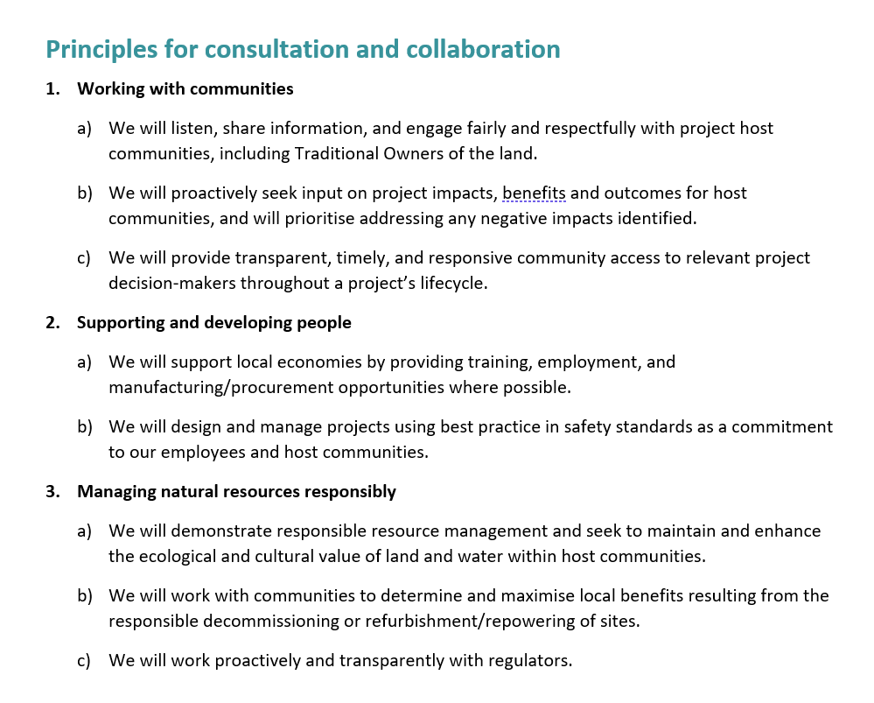
WHERE DID WE GET TO?
We developed principles for industry to engage with communities
We also drafted a draft guidance note, which is largely complete

Slide 3
NEXT STEPS FOR EXISTING WORK
Intent | What needs to be done | Detail | How? | Who? | By when?
NHS undertaking requirement | Complete draft guidance note | Case studies completion Further consultation? |  |  | End Q1
 | Engage with industry and others on operationalising | How to implement How to measure |  |  | End Q2
 | Case study compendium as additional support | Collect and complete Intent – website only? |  |  | End Q1
Broader public information – part 1 | Assess FAQs on the AHC website for gaps and complete as necessary |  |  |  | End Q1

Slide 4
NEW WORK
Intent | What needs to be done | Detail | How? | Who? | By when?
Broader public information – part 2 | Set up public repository of fact sheets, timelines, and ‘need to know’ information | AHC website and HyResource |  | Note interaction with CSIRO Hydrogen Mission | End Q1
 | Design and develop easy to understand factsheets | Draw on information already accessible on government and research websites with illustrative cases where available |  |  | End Q1
 | Develop comms strategy | Engage with Ministers with responsibility for hydrogen and relevant others on public comms |  |  | Mid Q2
 |  | Tasmanian project overlap?

Slide 5
NEW WORK
Intent | What needs to be done | Detail | How? | Who? | By when?
Engagement with project-affected communities | Identify communities likely to be ‘first affected’ by large, H2 demonstration projects | Make sure that community leaders are identified and start communications |  |  | Have approach mapped and meetings underway by end Q1
 | Develop and roll out community H2 roadshow | International context Big picture on H2 production Key issues – see undertaking Jobs and training opps | Virtual platform, newsletters etc |  | Development Q2-Q3 Delivery Q4?
 | Develop and roll out H2 schools programme | As above but tailored for students | Virtual platform, school assemblies, science fairs |  | Development Q2-Q3 Delivery Q4?
Broader public information – part 1 | Establish a Hydrogen Commission to engage others | See community influencers and invite to become ambassadors who can roll our the roadshow |  |  | Development Q4, ready for 2022?
Notes:
Community leaders - e.g., School Principals, RSLs, CWA branches, Rotary Clubs, Bowls Clubs, Small Business Associations, Aboriginal Corporations, etc.)
Develop an education roadshow for community groups with PPT, fact sheets, short video(s)
Share international context: Germany, Chile, Japan, South Korea, France, UK, Denmark
Describe likely export markets
Map demonstration projects in port cities (tailor for each state/territory)
Big picture overview of how hydrogen is likely to be made
Reference training and jobs opportunities
Acknowledge opportunity to develop domestic H2 assets for power, transport, energy storage – refer to HyResource and AHC websites for more information
Develop FAQ – long-term benefits delivered/short-term changes needed
Gather emails and commit to a quarterly H2 news email
Develop an education roadshow for U18s (primary and secondary school – students/teachers) with PPT, age-appropriate fact sheets, short video(s) for different age groups
Give an energy overview – “where does my energy come from?” – electricity (renewable and fossil fuel); gas; biofuels; hydrogen
Contextualise Australia’s energy present and contrast with future possibilities
Map demonstration projects in port cities (tailor for each state / territory)
Big picture overview of how hydrogen is likely to be made
Talk about STEM study and training opportunities
Establish a social media presence and update fortnightly
Develop FAQ – caring for people and planet while powering your world
Gather emails of interested teachers and principals to cultivate a dynamic relationship – commit to a quarterly H2 News email
Establish a Hydrogen Commission
Work with jurisdictional governments to identify community influencers and invite them to become AHC ambassadors capable of running shorter versions of the roadshows
Have group elect an AHC Commissioner as their representative to the AHC
AHC Commissioner would have an honorarium/stipend provided by their state/territory as compensation for time and effort

Slide 6
END
AHC contact
Fiona Simon, CEO
e fsimon@H2council.com.au
m 0474 028 740
w H2council.com.au

